Slide 1
Hospital Management System
By : Konstantin Permin (10624223)
&
Sabina Sadykova (10624226)

Slide 2
Introduction
The primary goal of this study is to design and implement a robust "Hospital Management System" that automates healthcare workflows such as patient registration, doctor scheduling, surgical history tracking, and financial billing. The project demonstrates the practical application of a hybrid database approach: using a Relational Database (PostgreSQL) for transactional integrity and a NoSQL Database (MongoDB) for flexible, high-performance data retrieval.

Slide 3
Hospitalization Requirement: A patient cannot be hospitalized without being assigned to a specific Ward with available Capacity.
The Foundation: Business Rules & Domain Definition
Before technical implementation, we established the "Hospital Policy" to define how data moves through the system. We identified key business rules such as:
A patient cannot be hospitalized without being assigned to a specific Ward with available Capacity.
Every financial transaction and bill must have a strictly tracked payment status.
The system manages 11 critical entities, including Doctors, Patients, Wards, and Surgeries. This phase allowed us to map complex healthcare processes into a structured data format.

Slide 4
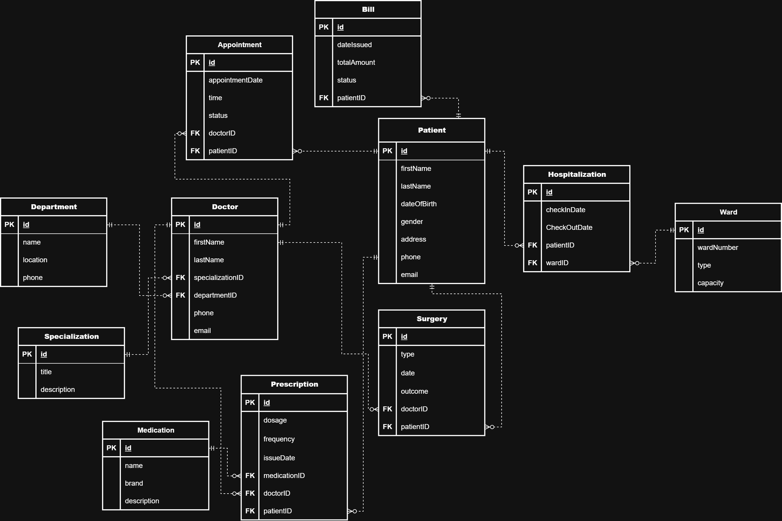

Slide 5
Database Implementation (PostgreSQL)
We converted our ER model into a Relational Schema, applying the 3rd Normal Form (3NF). This ensures that every piece of information is stored in exactly one place, eliminating data redundancy.
Technical Features:
Implemented 11 interconnected tables in pgAdmin.
Primary Keys: Ensured unique identification for every record.
Foreign Keys: Established rigid links between tables (e.g., linking a Surgery record to a specific Patient).
Constraints: Used NOT NULL and UNIQUE constraints to maintain high data quality and prevent "garbage" data.

Slide 6
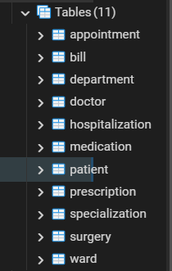
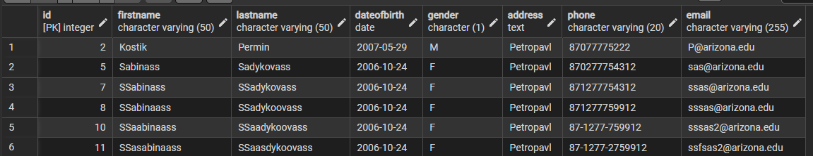
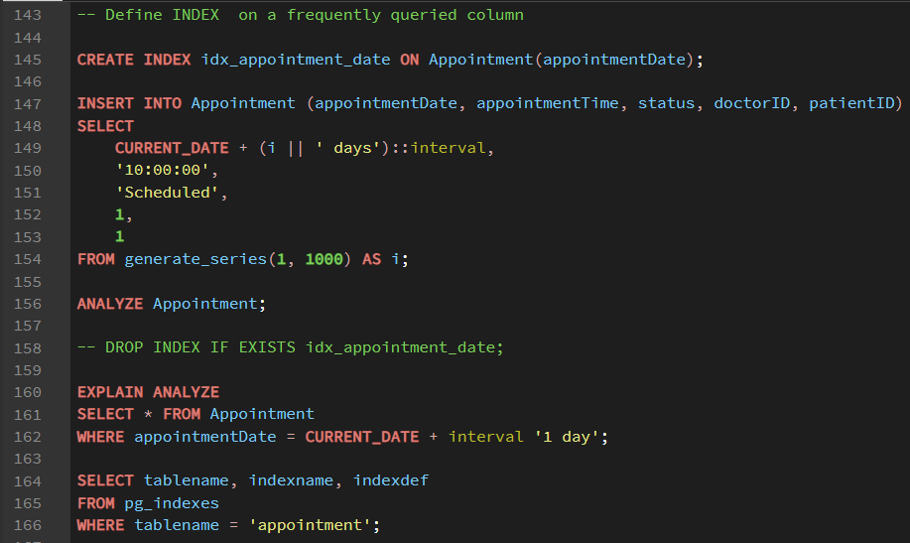

Slide 7
Database Optimization (Indexing)
To maintain high performance as the hospital database grows, we implemented strategic indexing. This ensures that critical medical data, such as appointment schedules, can be retrieved instantly without full table scans.
Technical Features:
B-Tree Indexing: Created the idx_appointment_date index on the Appointment table to optimize date-based queries
Performance Boost: Shifted database execution from a slow Sequential Scan to a high-speed Index Scan.
Query Analysis: Validated efficiency using the EXPLAIN ANALYZE command to monitor execution time.
Implementation: Used generate_series to test the index against a dataset of 1,000 records,

Slide 8
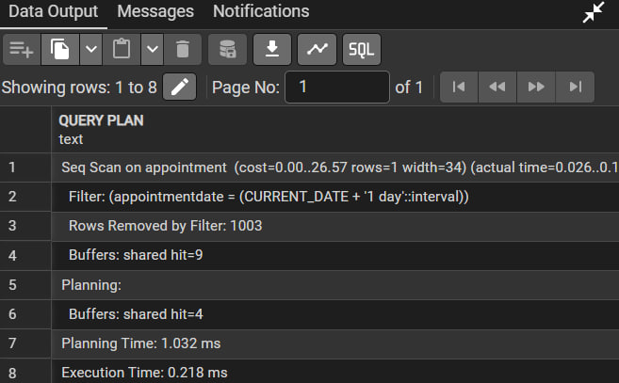
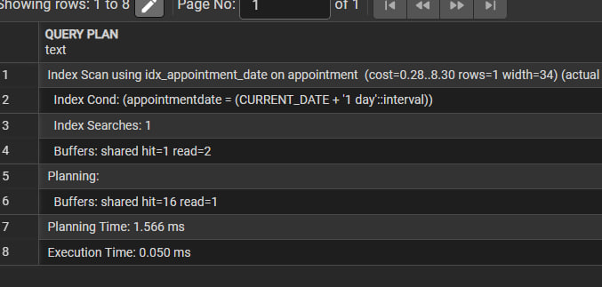

Slide 9
Database Implementation (MongoDB)
For the medical history part of our project, we chose MongoDB to handle non-relational data.
Embedding Strategy: Instead of splitting data into many tables, we store surgery records and bills directly inside the Patient document.
Performance Optimization: This design is optimized for "Read-Heavy" operations. A doctor can retrieve a patient’s entire history in a single query without using slow "Join" operations.
Validation: We implemented JSON Schema Validation to enforce data types, making our NoSQL collections as reliable as SQL tables.

Slide 10
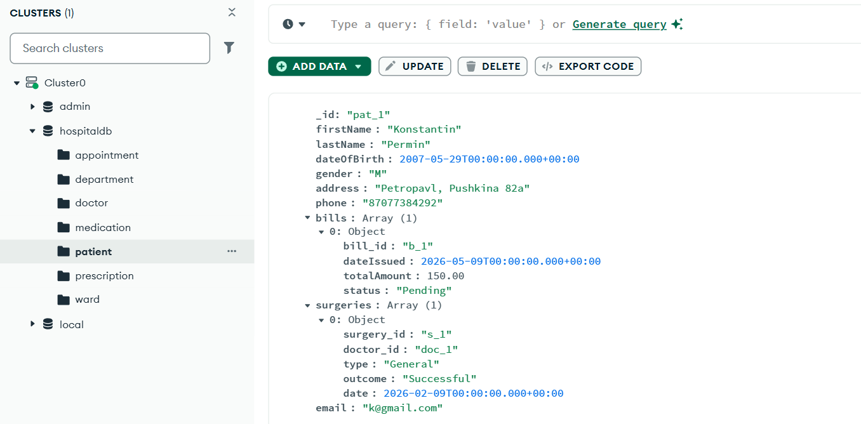

Slide 11
Bridging the Gap: The Java Application
We developed a functional application using Java and IntelliJ IDEA to interact with the PostgreSQL database.
Connectivity: We used JDBC (Java Database Connectivity) as a translator between our code and the SQL server.
Full CRUD Support: The application allows users to:
Create: Register new patients.
Read: Search and view patients.
Update: Modify patient details.
Delete: Remove records when necessary. This demonstrates the real-world usability of our database design.

Slide 12
Conclusion
Our project successfully demonstrates how to build a complex, multi-layered system.
PostgreSQL provides the transactional security (ACID) needed for billing and registration.
MongoDB offers the speed and flexibility required for medical history retrieval.
Java acts as the interface that brings these technologies together for the end-user. By following a strict workflow—from Business Rules to Indexing—we created a system that is both reliable and highly efficient.

